Slide 1
DB2 SQL Select
DB2 Training class 09

Slide 2
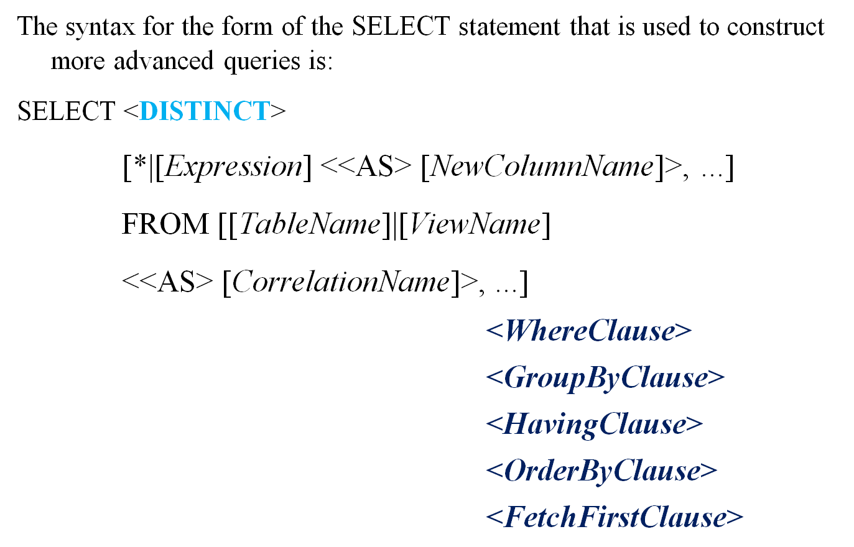
A Closer Look at the SELECT Statement

Slide 3
Seven Different Clauses
These clauses are processed in the order shown
    The DISTINCT clause
    The FROM clause: Identifies the Table Name
    The WHERE clause
    The GROUP BY clause
    The HAVING clause
    The ORDER BY clause
    The FETCH FIRST clause

Slide 4
DISTINCT
Suppose you wanted to retrieve every unique value (no duplicates) for a column in a table
  SELECT DISTINCT job FROM employee
If you wanted to change the name of the column in the result data set produced. You could do so by executing a SELECT statement that looks something like this:
  SELECT DISTINCT job AS title FROM employee

Slide 5
The WHERE Clause
The WHERE clause is used to tell the DB2 Database Manager how to select the rows based on a condition.
Six common types of WHERE clause
Relational Predicates: <, >, <=, >=, =, <>
BETWEEN: BETWEEN 60000.00 AND 70000.00
LIKE: LIKE ‘S_’ and 'S%'
IN : IN (‘W01’,W02’)
EXISTS
IS NULL
Each of these predicates can be used alone, or they can be combined

Slide 6
GROUP BY Clause & HAVING Clause
GROUP BY Clause
The GROUP BY clause is used to tell the DB2 Database Manager how to organize rows of data returned in the result data set produced in response to a query.
EX: SELECT WRKDEPT,MAX(ESAL) FROM EMPTABLE GROUP BY WRKDEPT;
The HAVING Clause
The HAVING clause is used to apply further selection criteria to columns referenced in a GROUP BY clause. This clause behaves like the WHERE clause, except that it refers to data that has already been grouped
Ex: SELECT WRKDEPT,MAX(ESAL) FROM EMPTABLE GROUP BY WRKDEPT HAVING MAX(ESAL) < 6000;

Slide 7
ORDER BY clause
The ORDER BY clause is used to tell the DB2 Database Manager how to sort and order the rows that are to be returned in a result data set
If the keyword ASC follows the column's name, ascending order is used, and if the keyword DESC follows the column name, descending order is used.
  Ex1 : SELECT EMPNO,ENAME,ESAL FROM EMPTABLE ORDER BY EMPNO;
  Ex2 : SELECT EMPNO,ENAME,ESAL FROM EMPTABLE ORDER BY ENAME,ESAL DESC;

Slide 8
FETCH FIRST Clause
The FETCH FIRST clause is used to limit the number of rows returned to the result data set produced in response to a query.
When used, the FETCH FIRST clause is followed by a positive integer value and the words ROWS ONLY.
  Ex:
  SELECT EMPNO,ENAME,WRKDEPT FROM EMPTABLE FETCH FIRST 2 ROWS ONLY;

Slide 9
SQLCODE

Slide 10

SQLCODES S9(9) COMP-3
CODE | DESCRIPTION
000 | Successful
+100 | End of the table/not found
-204 | Object not defined
-205 | Column not found select
-206 | Column not defined insert
-305 | Null indicator required
-500…. | Cursor and referential integrity
-803 | Duplicate key value
-805 | Plan not found

Slide 11
SQLCODE
CODE | DESCRIPTION
-811 | Single tone statement
-818 | Time stamp mismatch
-904 | Resource unavailable
-911 | Dead lock
-922 | Authorization failure

Slide 12
Thank You

